Slide 1
SuperMatching: Feature Matching using Supersymmetric Geometric Constraints
Submission ID: 0208
Notes:
SuperMatching, feature matching using supersymmetric geometric constraints

Slide 2
Overview
SuperMatching is:
A fundamental matching algorithm in GRAPHics and VISION tasks
Notes:
Supermatching is a fundamental matching algorithm in computer graphics and computer vision task,
The animation show one pairwise matching using uniformly sampled points on the 3D shapes

Slide 3
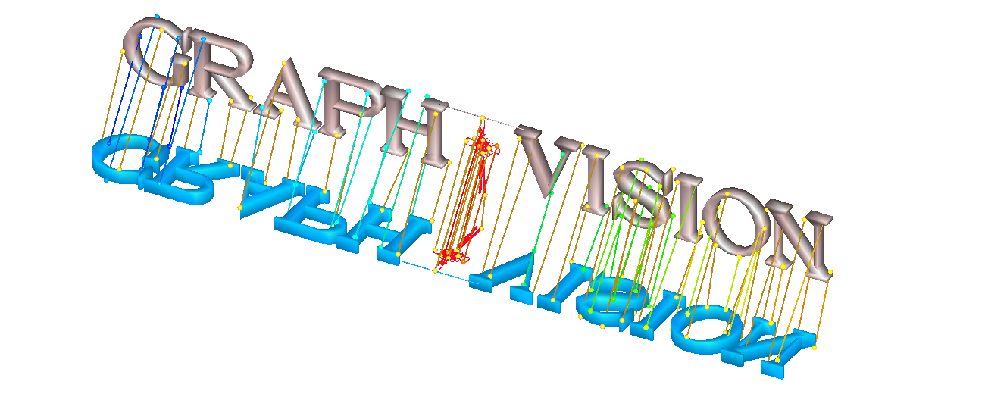
Overview
SuperMatching is:
A fundamental matching algorithm in GRAPHics and VISION tasks
Pairwise matching using uniformly sampled points on the 3D shapes
Notes:
Supermatching is a fundamental matching algorithm in computer graphics and computer vision task,
The animation show one pairwise matching using uniformly sampled points on the 3D shapes

Slide 4
Overview
SuperMatching is:
Using feature tuples (triangles or higher-order tuples)
Formulated as a supersymmetric higher-order affinity tensor
Notes:
SuperMatching uses feature tuples (triangles or higher-order tuples), going beyond the pointwise and pairwise approaches typically used.
SuperMatching is formulated using a supersymmetric tensor representing an affinity metric which takes into account feature similarity and geometric constraints between features.
For example, for a third-order diagram. The geometric constraints are edge length invariance in 3D.

Slide 5
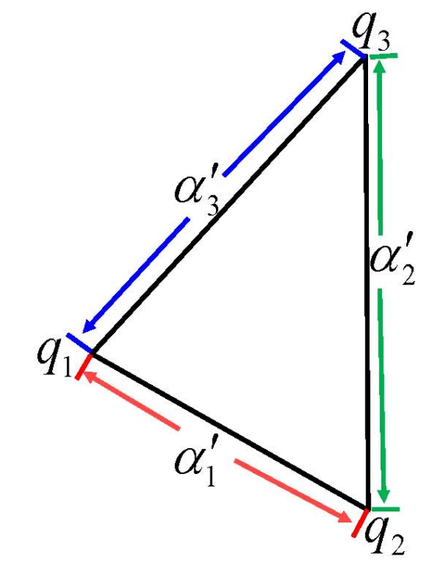
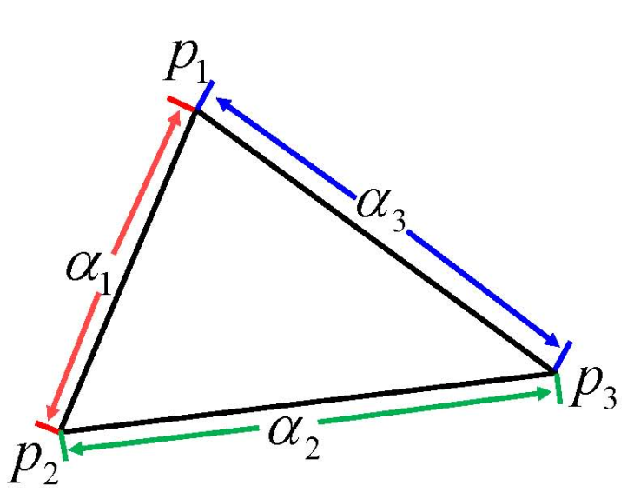
Overview
SuperMatching is:
Using feature tuples (triangles or higher-order tuples)
Formulated as a supersymmetric higher-order affinity tensor
Third-order diagram (edge length invariance in 3D triangles)
Notes:
SuperMatching uses feature tuples (triangles or higher-order tuples), going beyond the pointwise and pairwise approaches typically used.
SuperMatching is formulated using a supersymmetric tensor representing an affinity metric which takes into account feature similarity and geometric constraints between features.
For example, for a third-order diagram. The geometric constraints are edge length invariance in 3D.

Slide 6
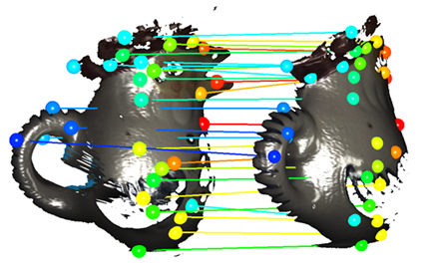
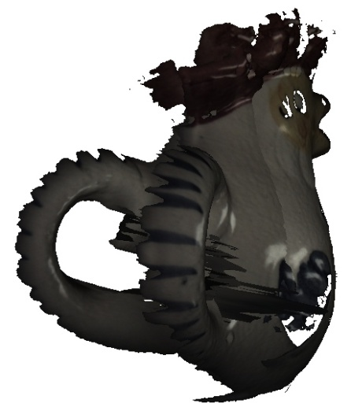
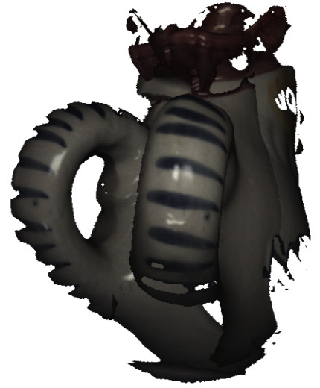
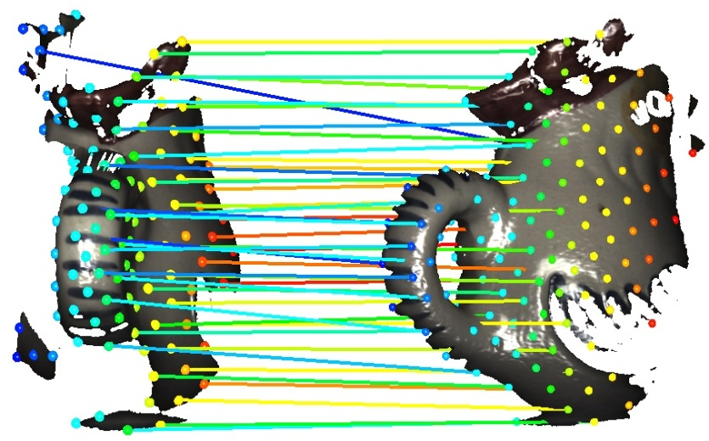
3D rigid shapes scans
Pairwise matching of Rooster scans
I
II
II
III
Initial poses Matching result
Notes:
SuperMatching could accurately build pairwise matchings between 3D rigid shape scans.
For the Rooster scans between I and II, between II and III, the correspondences are automatically determined by the SuperMatching

Slide 7
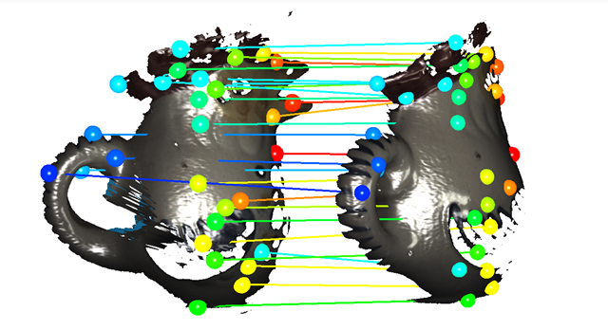
3D rigid shapes scans
Pairwise matching of Rooster scans
I
II
II
III
Initial poses Matching result
Notes:
SuperMatching could accurately build pairwise matchings between 3D rigid shape scans.
For the Rooster scans between I and II, between II and III, the correspondences are automatically determined by the SuperMatching

Slide 8
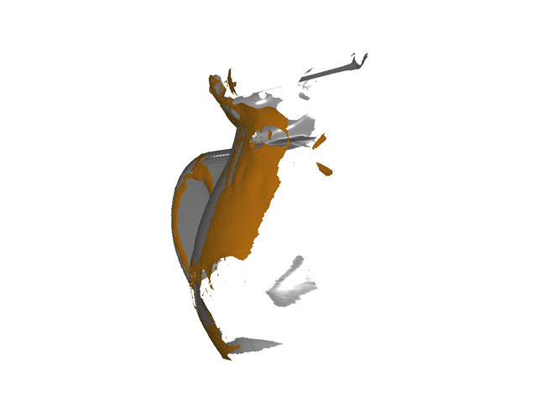
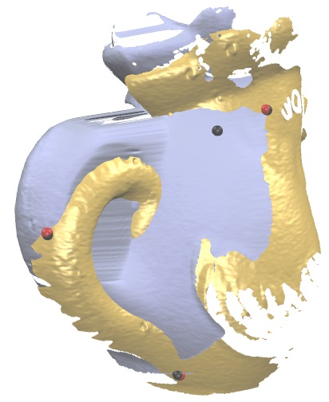
3D rigid shapes scans
Comparison with 4PCS [Aiger et al. 2008]
SuperMatching
[Aiger et al. 2008]
Rooster II-III pairwise registration
Notes:
Rigid transforms can be computed from each triple of compatible matching points.
Then a voting scheme could be used to find the optimal alignment transform, which is robust to the initial pose of the input scans.
The right animation shows the corresponding result produced by 4pcs, which has clearly failed, presumably as only 4 points were used to deduce the alignment.

Slide 9
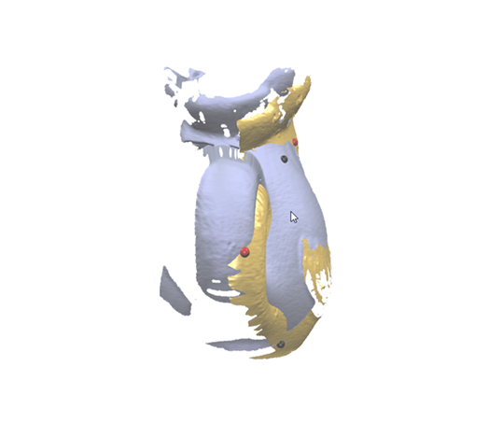
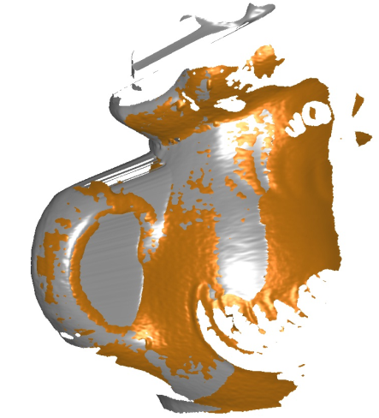
3D rigid shapes scans
Comparison with 4PCS [Aiger et al. 2008]
SuperMatching
[Aiger et al. 2008]
Rooster II-III pairwise registration
Notes:
Rigid transforms can be computed from each triple of compatible matching points.
Then a voting scheme could be used to find the optimal alignment transform, which is robust to the initial pose of the input scans.
The right animation shows the corresponding result produced by 4pcs, which has clearly failed, presumably as only 4 points were used to deduce the alignment.

Slide 10
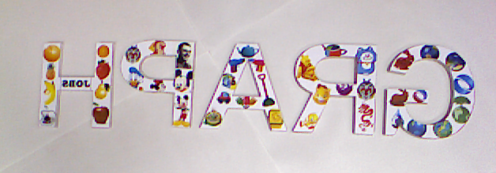
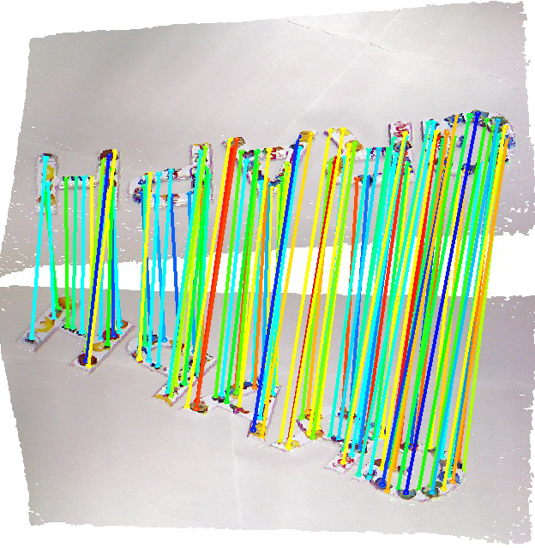
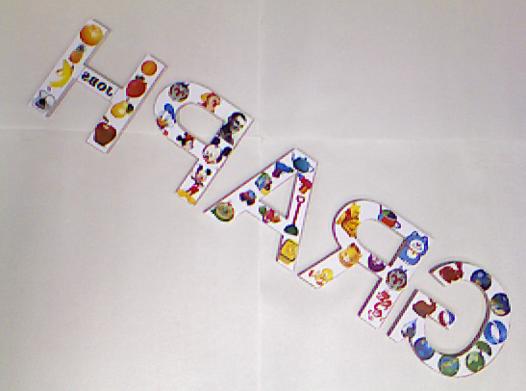
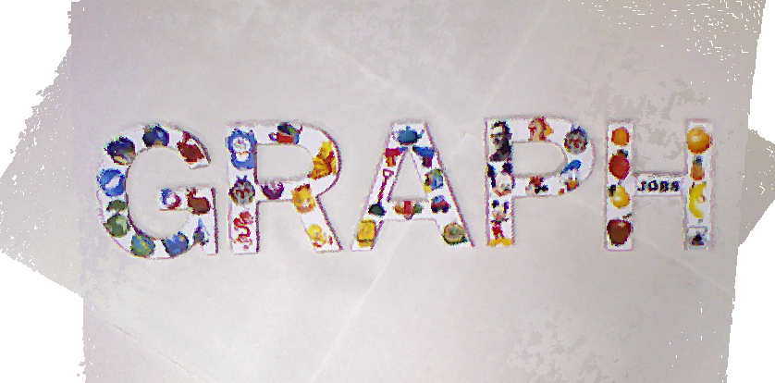
3D real depth scans
Colored Scene captured by Kinect
Source shape
Target shape
Final alignment
Pairwise Matching
Notes:
We next provide a further real-world, noisy, example of the use of SuperMatching.
The scene was captured using a Kinect camera.

Slide 11
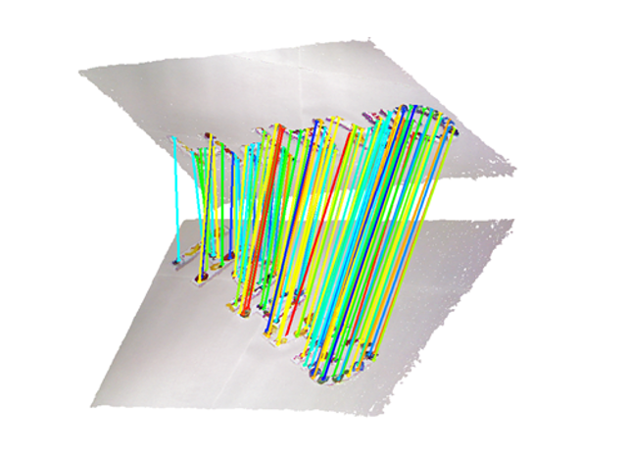
3D real depth scans
Colored Scene captured by Kinect
Notes:
The animation shows the matching results for the colored scene captured by Kinect.

Slide 12
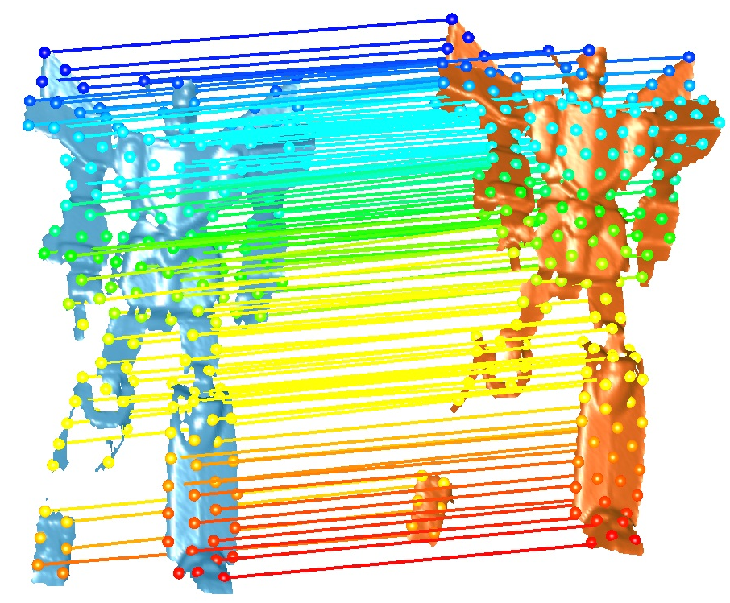
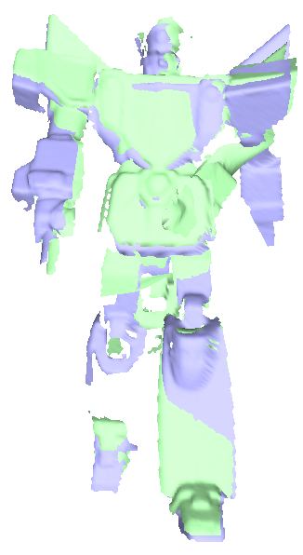
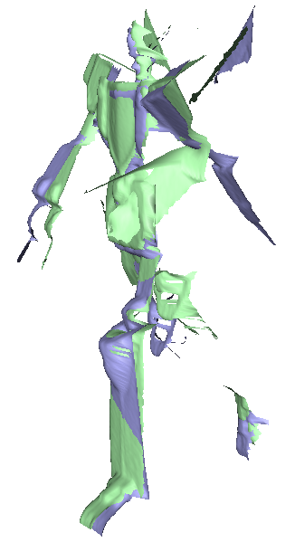
3D articulated shapes
Articulated Robot between frame 9 and 10
distortion
SuperMatching
[Chang and Zwicker 2009]
Notes:
A further application is registration of (approximately) articulated shapes.
For the Articulated Robot between frame 9 and 10, both SuperMatching and Chang’s results are shown to make the comparison.

Slide 13
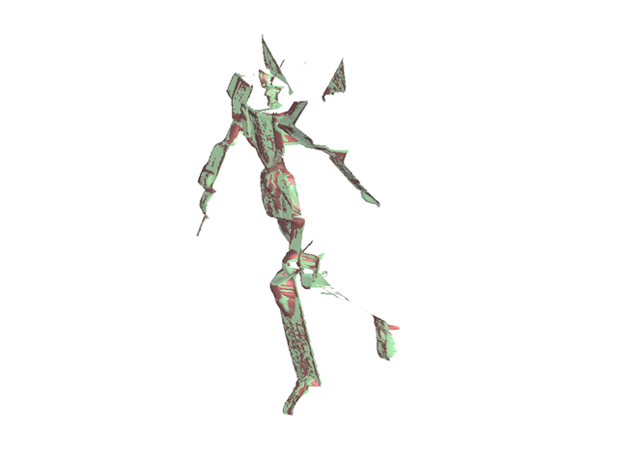
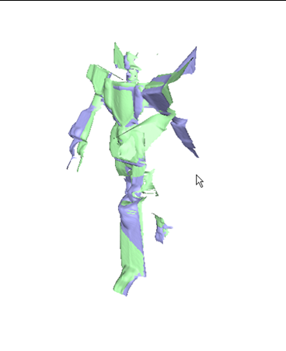
3D articulated shapes
Articulated Robot between frame 9 and 10
SuperMatching
[Chang and Zwicker 2009]
Notes:
Articulated Robot between frame 9 and 10, the matching results are snapped.

Slide 14
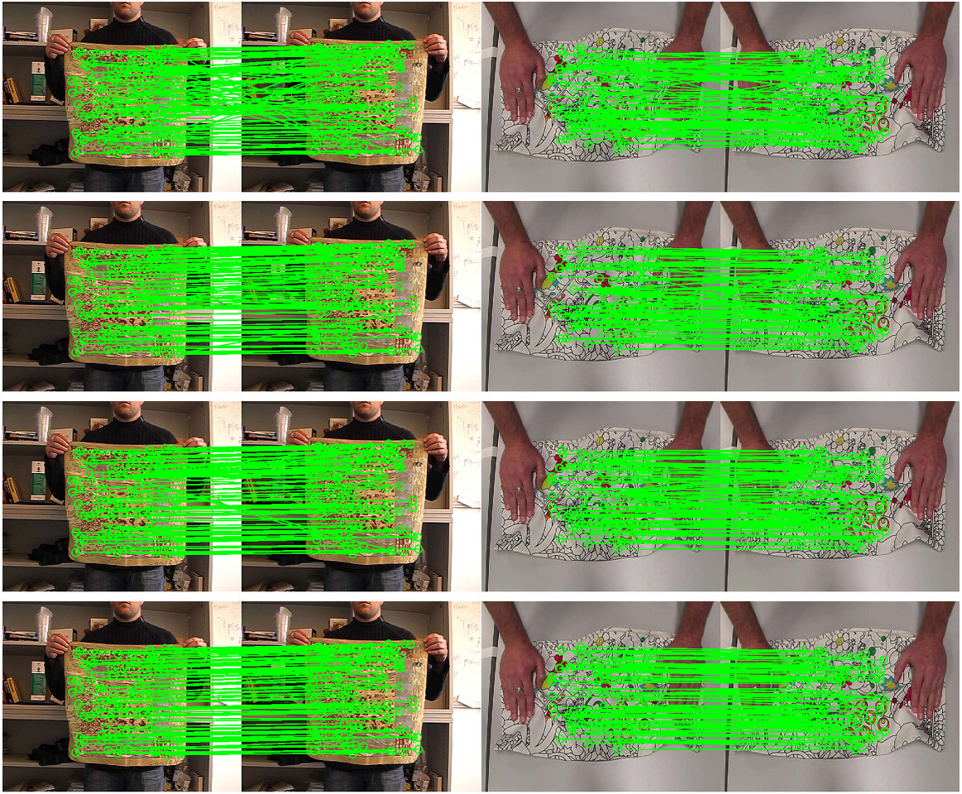
Deformable surfaces
Spectral method
[Cour et al. 2006]
Hypergraph matching
[Zass and Shashua 2008]
A third-order tensor
[Duchenne et al. 2009]
SuperMatching
cloth: F80-F90
cushion: F144-F156
Notes:
Finally, we matched SIFT points on images of deforming surfaces showing a cloth and a cushion.
This slide shows the results for spectral method, hypergraph matching, a thrid-order tensor, and the supermatching on Frame 80-90 for the cloth, frame 144-156 for cushion.
It is visible that supermatching produced the better matching.

Slide 15
Deformable surfaces
Accuracy and Time-costs
Dataset | cloth |  |  |  | cushion
Pairwise Matching | F80- F90 | F90- F95 | F95- F100 | F100- F105 | F144- F156 | F156- F165 | F165- F172 | F172- F188 | Times (Sec)
Super-Matching | 83% | 85% | 84% | 81% | 66% | 60% | 69% | 56% | 8
[Zass and Shahua 2008] | 73% | 79% | 70% | 72% | 44% | 39% | 54% | 43% | 6.5
[Duchenne et al. 2009] | 67% | 77% | 73% | 65% | 39% | 31% | 47% | 42% | 13
[Cour et al. 2006] | 27% | 29% | 22% | 27% | 14% | 5% | 28% | 7% | 5
Notes:
This Table demonstrates the matching accuracy and time performance.
All methods were executed in Matlab on a PC.
To enable direct and fair comparison, we used the same potential and the same tensor size for all high-order algorithms.

Slide 16
Deformable surfaces
Accuracy and Time-costs
Dataset | cloth |  |  |  | cushion
Pairwise Matching | F80- F90 | F90- F95 | F95- F100 | F100- F105 | F144- F156 | F156- F165 | F165- F172 | F172- F188 | Times (Sec)
Super-Matching | 83% | 85% | 84% | 81% | 66% | 60% | 69% | 56% | 8
[Zass and Shahua 2008] | 73% | 79% | 70% | 72% | 44% | 39% | 54% | 43% | 6.5
[Duchenne et al. 2009] | 67% | 77% | 73% | 65% | 39% | 31% | 47% | 42% | 13
[Cour et al. 2006] | 27% | 29% | 22% | 27% | 14% | 5% | 28% | 7% | 5
More accurate with competitive time
Notes:
This Table demonstrates that SuperMatching achieves a higher matching accuracy than previous algorithms with competitive time cost.

Slide 17
Deformable surfaces
Accuracy and Time-costs
Dataset | cloth |  |  |  | cushion
Pairwise Matching | F80- F90 | F90- F95 | F95- F100 | F100- F105 | F144- F156 | F156- F165 | F165- F172 | F172- F188 | Times (Sec)
Super-Matching | 83% | 85% | 84% | 81% | 66% | 60% | 69% | 56% | 8
[Zass and Shahua 2008] | 73% | 79% | 70% | 72% | 44% | 39% | 54% | 43% | 6.5
[Duchenne et al. 2009] | 67% | 77% | 73% | 65% | 39% | 31% | 47% | 42% | 13
[Cour et al. 2006] | 27% | 29% | 22% | 27% | 14% | 5% | 28% | 7% | 5
More accurate with competitive time

Slide 18


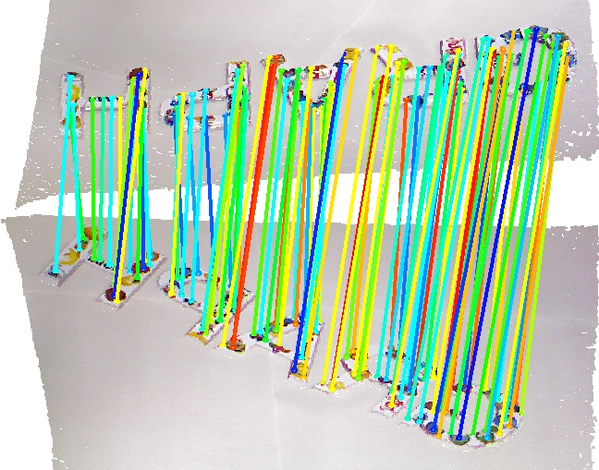
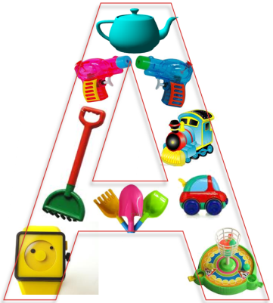
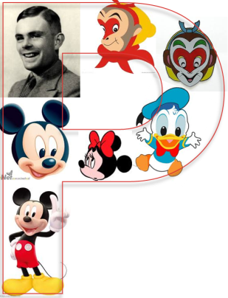

Thanks
Real 3D data captured by Kinect
Notes:
Thank you.

Slide 19
Thanks
JOBS
Real 3D data captured by Kinect
Notes:
Thank you.

